Slide 1

GreenMart
PUSL2024
Software Engineering 2

Slide 2
Group Members
 | Group Number | A 24
 | Student ID (Plymouth) | Name (as appeared on DLE)
1 | 10898536 | Henaka Kumara
2 | 10749144 | Kaluthanthri Patabadi
3 | 10898502 | Shakya Jayathilaka
4 | 10898467 | Tharushi Galappaththi
5 | 10898438 | Jayasundara Dasumi
6 | 10908162 | Horagala Piyumani

Slide 3
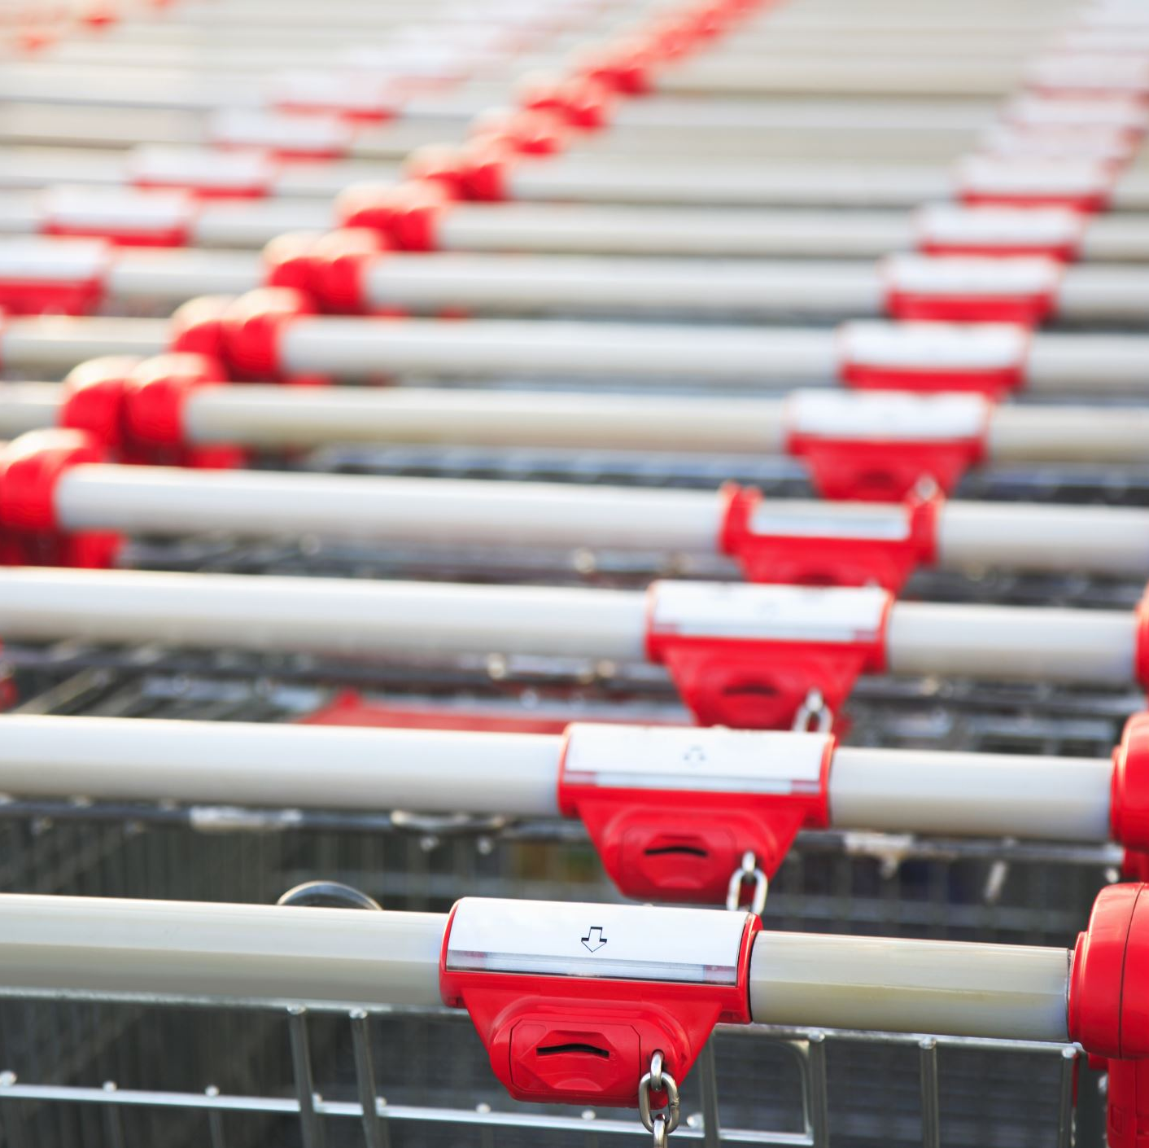
Introduction
GreenMart is a website which presents an online platform for a supermarket. This is a dynamic website made using Java and JavaScript.
GreenMart is consist of webpages such as,
Home
Grocery
Vegetables/Fruits
Meat
House holder items
Login/Signup
Add to cart
Payment Method

Slide 4
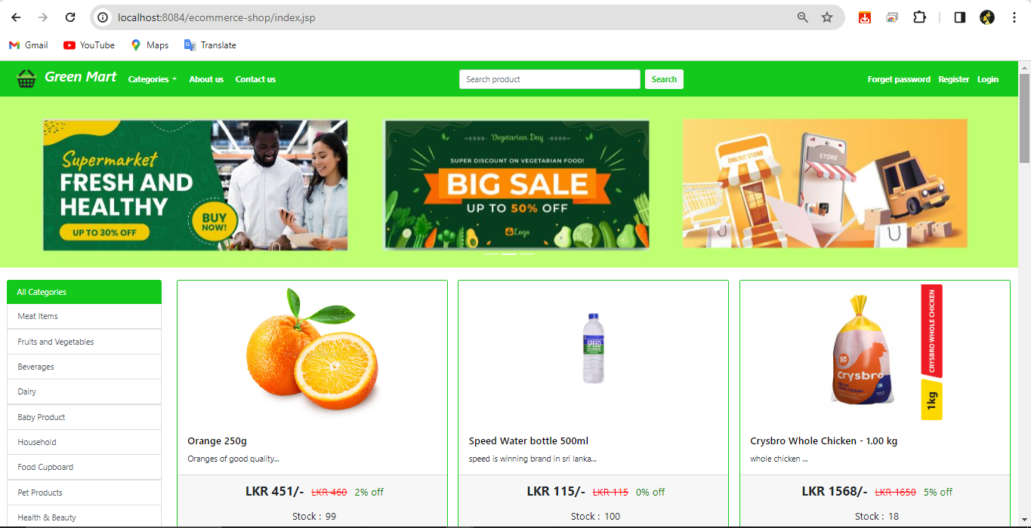
Home

Slide 5
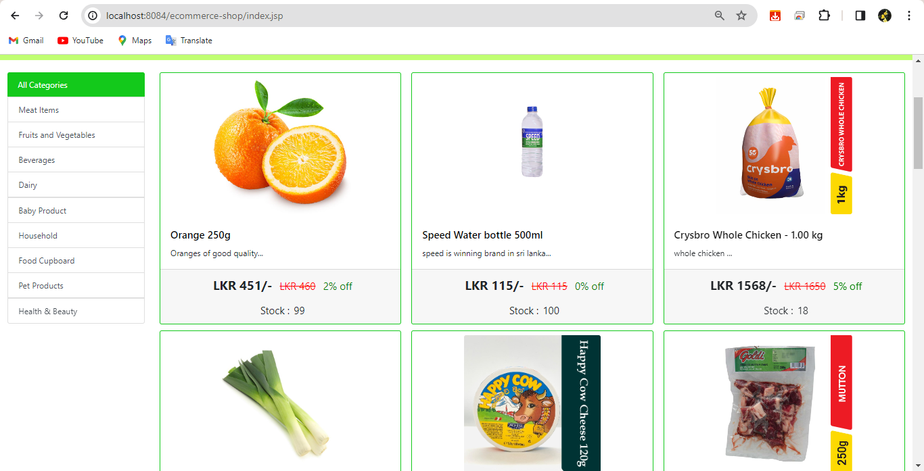
Grocery

Slide 6
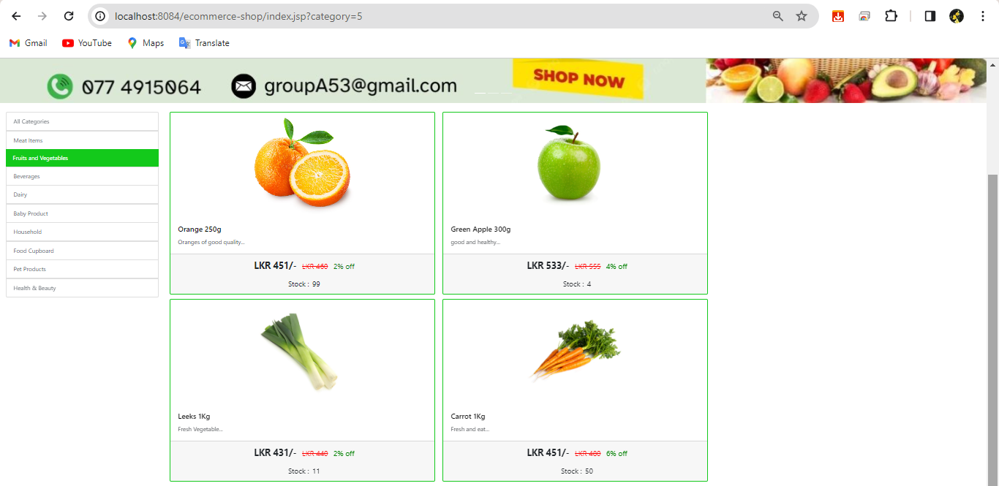
Vegetables/Fruits

Slide 7
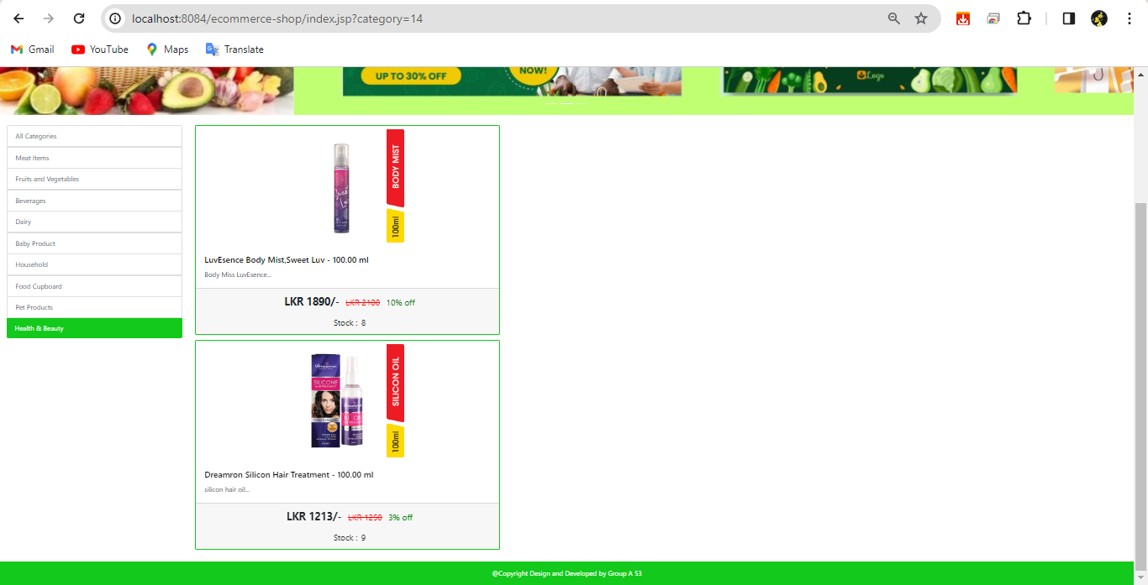
Health and Beauty

Slide 8
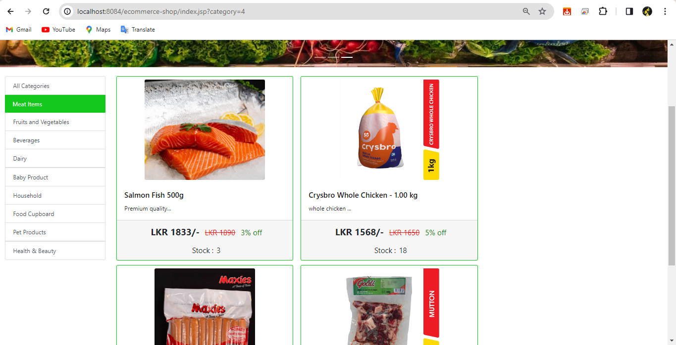
Meat Items

Slide 9
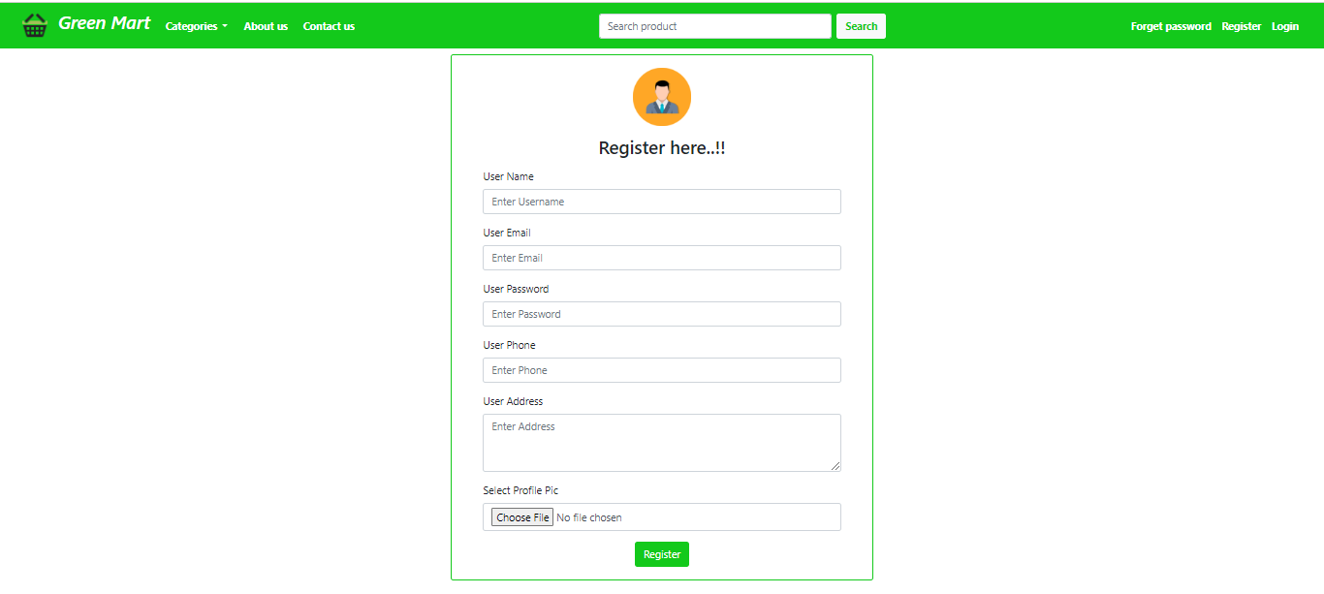
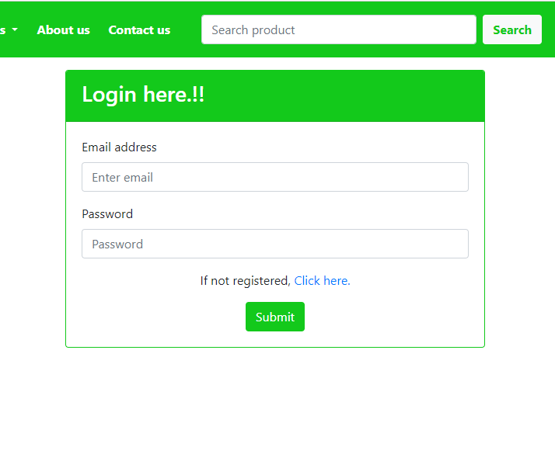
Login / Register

Slide 10
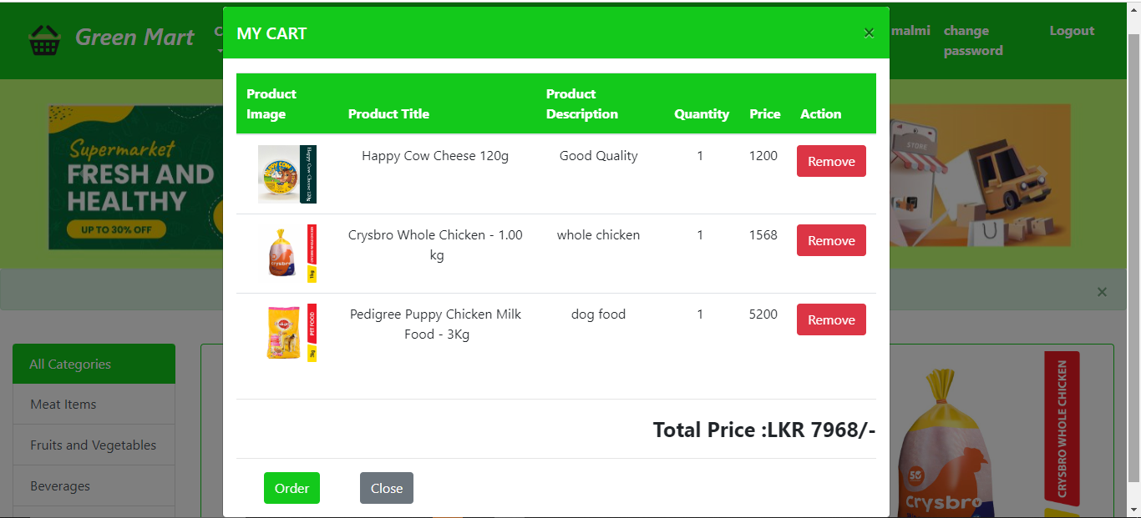
Add to Cart

Slide 11
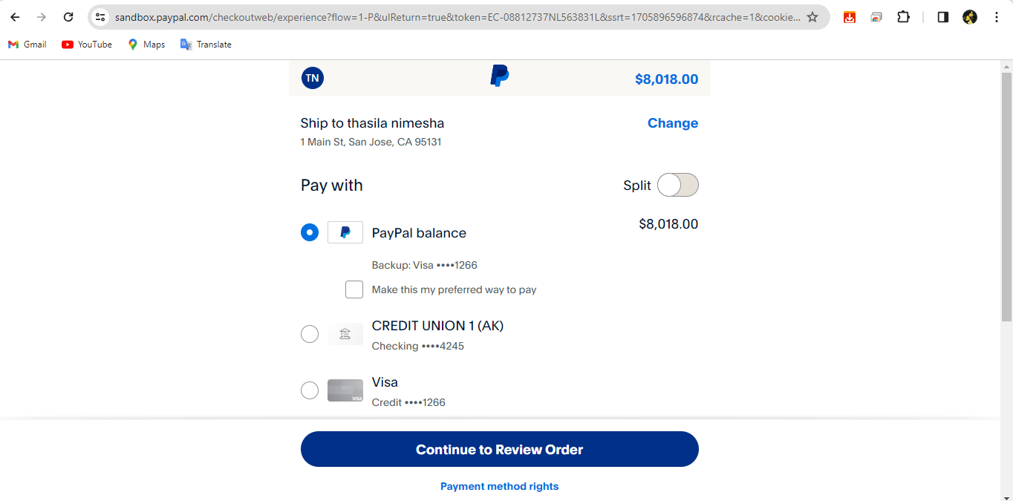
Payment Method

Slide 12

Challenges
Coding errors
Breakdown in the system
Creating and connecting database
Adding a paypal method
Communication among group members

Slide 13


